Slide 1
Heart Monitor
Embedded Systems Project
Spring 2020

Slide 2
Application

Slide 3
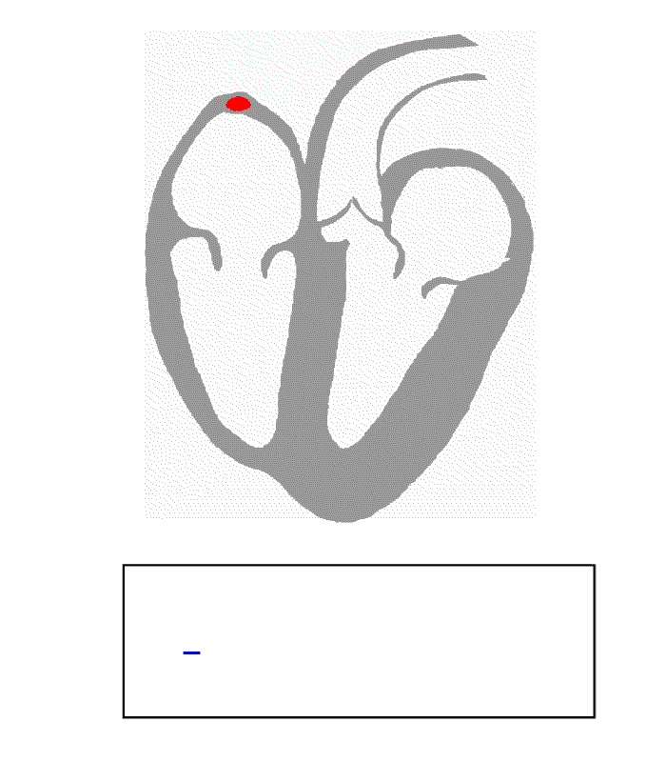
Electrocardiogram (ECG)
Measure electric activity from the heart
Extract information about the heart

Slide 4
Design

Slide 5
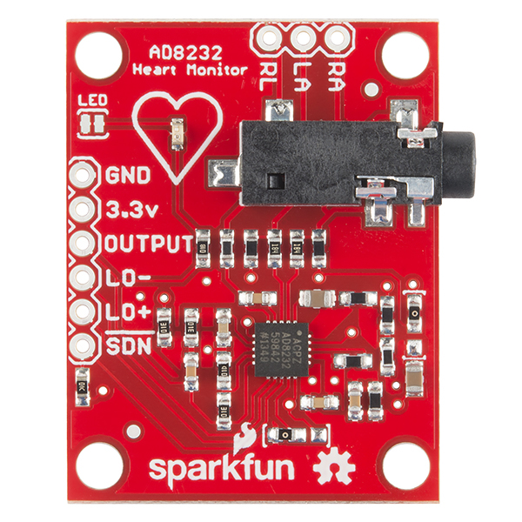
Component 1:
AD8232
Notes:
SIgnal COnditioning circuit
Freq
Vref

Slide 6
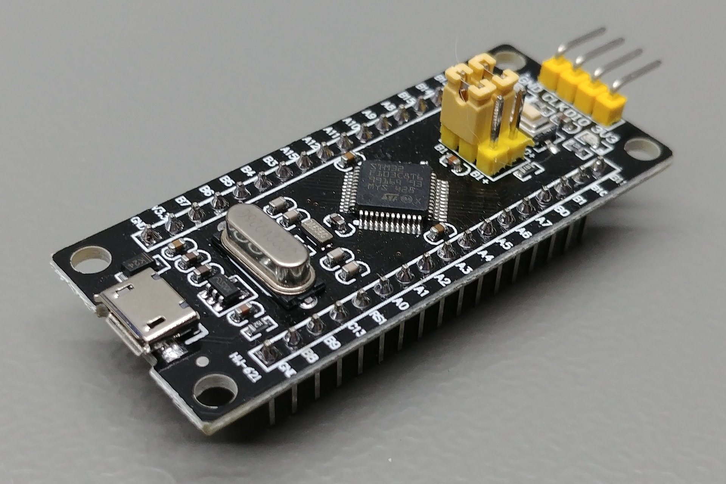
Component 2:
STM32F103C8T6

Slide 7
Component 3:
Software
Pyserial
Matplotlib
Tkinter

Slide 8

Block Diagram
Application
STM32F103C8T6
UART
AD8232
Serial Connection
ADC Out
Electrode Pads

Slide 9
Implementation

Slide 10
Code Walkthrough
https://github.com/Goldent00thbrush/Heart_Monitor

Slide 11
Demo

Slide 12
Thank you.
Any Questions ?

